Slide 1







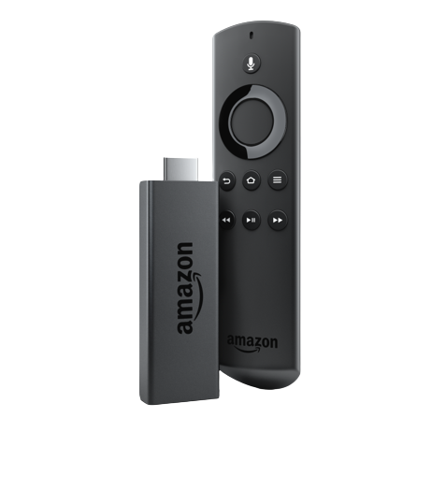
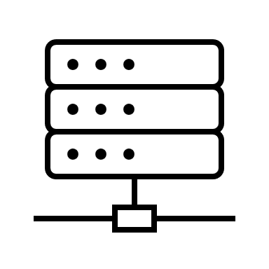









Understanding the Amazon Luna Ecosystem
Get Access to Multiple Games By
Subscription to Channels
Browse Games in Library
Add Favorite Games to Playlist
Continue Where you left off
Control Game Using
Amazon Luna Controller
Other Compatible Controllers
Luna Controller
Compatible Controllers
Channels
How you Want To Play
What you Want To Play
A Min of 10 Mbps
Game Logic Server
Game Database
Video Compressor
Amazon Firestick
Samsung Collaboration
Share Gaming Experience Using
Couch –
Invite anyone in the mainland U.S, Alaska and Hawaii To Watch or Join In on Gameplay
Amazon Account and Controller Needed.
No subscription Needed
Broadcast Directly to Twitch
Couch
Broadcast
Access Games Using
Devices run on Multiple platforms
Device Owned By Amazon
Devices Owned By Partners (Samsung)
Apps and Browsers
Services
Platform
How you Want To Share
Where you Want To Play

Slide 2

How to Play
What to Play
Control Game Using
Amazon Luna controller
Other compatible controllers
Get Access to Multiple Games By
Subscription to Channels
Browse Games in Library
Add favorite games to playlist
Continue Where you left off
Luna Controller
HyperX Gaming Console
Game Pills – Small storage device that can Store one AAA game and be inserted into console
Pill Stations – Station to download & switch games
Channels
Cloud gaming ecosystem
Game Pill ecosystem to minimize transactions between cloud and device.
Lesser connectivity requirements
Compatible Controllers
Where to Play
Game Logic Server
Game Database
Video Compressor
How to Share
Access Games Using
Devices run on multiple platforms
Device owned by amazon
Devices Owned by partners (Samsung)
Apps and browsers
* Cloud Gaming Services from HP
Share Gaming Experience using
Couch –
Invite anyone in the mainland U.S, Alaska and Hawaii to watch or join in on gameplay
Amazon account and controller needed.
No subscription needed
Broadcast directly to twitch
Amazon Firestick
Samsung Collaboration
Couch
Broadcast
Platform
HP Omen Series PCs
HyperX gaming accessories
Devices like firestick
Collaboration with partners like Amazon & Samsung
Browser
Services to share & broadcast
Services to Invite friends and Family to play
* Luna Requires a Minimum of 10 Mbps Network Speed | All recommendations/ ideas are in Italic

Slide 3
How to Play
What to Play
Control Game Using
Amazon Luna controller
Other compatible controllers
Get Access to Multiple Games By
Subscription to Channels
Browse Games in Library
Add favorite games to playlist
Continue Where you left off
OR
Channels
Cloud gaming ecosystem
Game Pill ecosystem to minimize transactions between cloud and device.
Lesser connectivity requirements
How HP Can Win
HyperX Gaming Console
Game Pills – Small storage device that can Store one AAA game and be inserted into console
Pill Stations – Station to download & switch games
Where to Play
Game Logic Server
Game Database
Video Compressor
How to Share
Access Games Using
Devices run on multiple platforms
Device owned by amazon
Devices Owned by partners (Samsung)
Apps and browsers
* Cloud Gaming Services from HP
Share Gaming Experience using
Couch –
Invite anyone in the mainland U.S, Alaska and Hawaii to watch or join in on gameplay
Amazon account and controller needed.
No subscription needed
Broadcast directly to twitch
Amazon Firestick
Samsung Collaboration
Couch
Broadcast
Platform
HP Omen Series PCs
HyperX gaming accessories
Devices like firestick
Collaboration with partners like Amazon & Samsung
Browser
Services to share & broadcast
Services to Invite friends and Family to play
* Luna Requires a Minimum of 10 Mbps Network Speed | All recommendations/ ideas are in Italic

Slide 4
Amazon’s end-to-end approach to Cloud gaming
Amazon Luna
HP Gaming
Input/Output
FLEXIBILITY
Luna works with proprietary controllers AND other platform controllers, enabling gamers to play with what they have
HP Gaming Options:
HP’s existing offerings OR
What does HP need to invest in
Asdfasdf
These can be bullets too.
The ask is a comparison of 2 companies more or less
The “So-what” is the next step. You have the data points, but you need the story. Start with “what is the story we want to tell” and then choose words that are descriptive
Design is critical but not focus
Choose the category names (e.g., How to Play >> Input/Output (still not the best))
Fill out the details of the slide
HP Options – play around with options 1, 2 or both
Title – give it a go. Provide a few iterations
Portfolio of Games
FLEXIBILITY
Luna works with proprietary controllers AND other platform controllers, enabling gamers to play with what they have
SW / Platform
Input/Output

Slide 5
Amazon’s end-to-end approach to Cloud gaming
Cloud Gaming
Amazon Luna
HP Gaming
Input/Output
FLEXIBILITY
Luna works with proprietary controllers AND other platform controllers, enabling gamers to play with what they have
HP Gaming Options:
HP’s existing offerings OR
What does HP need to invest in
Portfolio & Access
Software & Platform

Slide 6






































































Icons (Black ONLY)

Slide 7



































































Icons (Black ONLY)

